Slide 1
Clemson road creative
So You Want to be a Consultant?
City of Columbia Office of Business Opportunity
Notes:
Welcome to Clemson Road Creative’s The ROAD Methodology learning module number one, What is Consulting?

Slide 2
Just another …
Dr. Kasie Whitener
Entrepreneur at Clemson Road Creative
Business Lecturer at the
Darla Moore School @ UofSC
Published Novelist
Co-Founder of the Women’s Business Center of SC @ Columbia College
Co-Organizer of 1 Million Cups
Board of Directors of SC Writers Association
Chairperson, Richland County Libertarian Party
Radio show host, Write On SC

Slide 3
So you want to be a consultant?
In this workshop you will learn:
Basic vocabulary
● How to identify your niche
● How to build your service offering
● How to market yourself
● How to collect and prove results
Notes:
I’m Dr. Kasie Whitener and I’ll be leading you through this initial module “What is Consulting?” during which we’ll discuss a basic vocabulary -- how consultants refer to their work and industry. Why people hire consultants and what people become consultants. We’ll look at how to become one -- even taking an assessment to see if it’s the right fit for you -- and finally the Real Work of Consulting which will set us up for Module 2.

Slide 4
Consultant
What is Consulting?
Subject Matter Expert
Functional Expertise
Industry Expertise
Experience
Longevity
Spectrum
Outsider View
No office politics
Fresh perspective on old problem
A person who provides expert advice professionally
This Photo by Unknown Author is licensed under CC BY
This Photo by Unknown Author is licensed under CC BY-NC
Notes:
What is consulting?
Delivering expertise to individuals with the intent of solving a specific problem. Consultants have the advantage of being subject matter experts (SMEs) in a particular field and bring to a project the experience of having executed similar work before. They are usually engaged for their knowledge but also for their outside-view, the fresh-eyes take on the project that eliminates the corporate politics of work being done by embedded individuals.
SMEs
Experience
Outsider view

Slide 5
s.u.p.e.r.
Why do people hire consultants?
S.U.P.E.R. Problems
Work on the peripheral of a company’s mission-critical activities
Bring a fresh perspective to a problem they’ve been unable to solve
Consultants are brought in to solve company’s problems that are:
Specific
Urgent
Persistent
Expensive
Recognizable

Slide 6
Have you ever hired a consultant?
What was the project? What was the outcome?

Slide 7
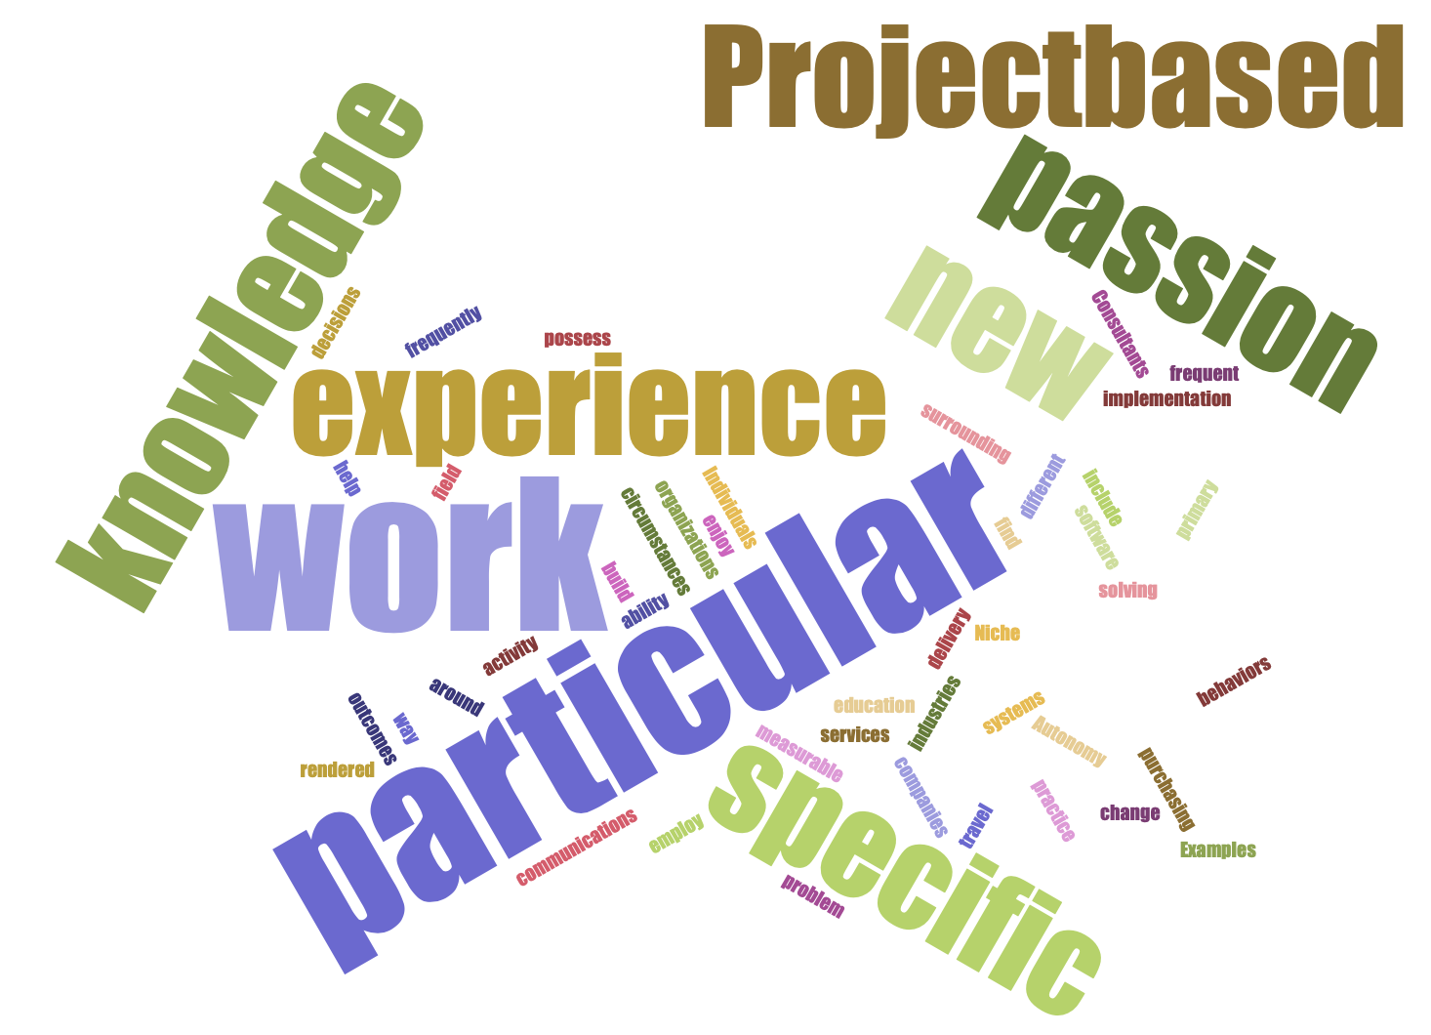
autonomy
Why do people become consultants?
Passion for a particular activity
Expertise in a particular skill or activity
Unique way of solving a specific problem
Autonomy
Niche
Experienced
The right to decide for oneself and pursue a course of action for one’s own life.
Used here to describe working conditions wherein consultants determine who their clients will be, what the work contract looks like, how much they’ll earn, and what deadlines they will honor.

Slide 8
assessment
The evaluation or estimation of the nature, quality, or ability of a person or thing.

Slide 9
Are you sure you want this?
What is your area of expertise? What is your level of experience?

Slide 10
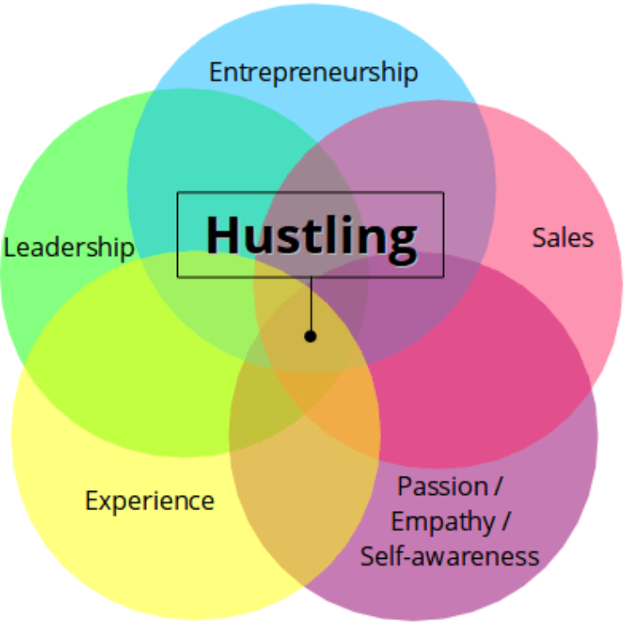
Self awareness
What are you passionate about?
What qualifies you as a Subject Matter Expert in that area?
What experience do you have in solving SUPER problems in that area?
What intangible qualities would you bring to a company in need of your consulting services?
What experience do you have in project-based work?
Do you have the tools to work autonomously?
What about working autonomously would challenge you?
Photo credit: joshuaspodek.com

Slide 11
The consulting business model
From “Traditional” Consultancies to Independent Consultants, the model varies, but maintains standards.

Slide 12
consultancy
How does Consulting work?
Major consultancies
win business
staff projects with subject matter experts
fulfill client contracts
Independent consultants
find their own work,
craft their own contracts, and
deliver services themselves.
The business that employs consultants is called a Consultancy and works on an Agency model. The consultancy finds and wins contracts and then staffs a project team to deliver services in fulfillment of the contract.
Alternatively, independent consultants are individual or solopreneurs who bear the responsibility for earning contracts and delivering services.

Slide 13
Clemson road creative
Never let the fear of striking out keep you from playing the game.
Shared Services Platform
Independent Consultants Keep their own company branding & operations
We support their operations with a portfolio of services:
Marketing
Knowledge Base / Learning Platform
Content Development
Documentation
Financial Services
Sales / Prospecting
Administrative support
We’re different.

Slide 14
Are you willing to build your own?
Being an entrepreneur means …

Slide 15
results
How does Consulting work?
A full assessment is done to determine what work needs doing.
The work is itemized into a project schedule.
The work units are completed and delivered.
The consultant makes recommendations for future work.
The client renders payment or extends the work schedule.
Consultants are brought in to deliver a final outcome that demonstrates expertise applied to solve a problem. The outcome is called the “Results” and it is the most important part of the consulting experience.
Results can earn future work, establish a consultant’s credibility, and improve a client’s working conditions. Results should be the primary focus of every engagement.

Slide 16
What You’ll need
Differentiation – The What
Processes – The How
What can you do?
Who do you do it for?
What problem do you solve?
How long does it take?
What tools will you need to solve it?
Discovery
Proposal
Statement of Work / Contract
Deliverables
Results

Slide 17
Build your service offering
Expert in …
Operations
Change Management
Specifically, I help with …
Communications
Evaluations
Work looks like …
Communications Plan & specific messages
Interviews & compiled results
Who are your customers?
How long is their buying cycle?
Who are the decision makers?
What information do they need?
How will you reach them?
How can you create / identify urgency?

Slide 18
marketing
Consultants sell knowledge. Expertise. So they must establish that knowledge with a series of progressive lessons:
Blog posts
Videos
Webinars
Workshops
eBooks
Keynotes

Slide 19
results
Your Statement of Work
Your Outcomes
Identified goal of the project
Identified measurable outcomes
Specific work units you will deliver
Timeline for work unit delivery
Assumptions that protect the integrity of the project
Payment & invoice schedule
Agreement / Signatures
What problem you solved
The specific change you measured
The itemized work you produced
The met deadlines acknowledged
The failed assumptions that resulted in delays or missed deadlines

Slide 20
You’ve got work to do.
Customer Validation: Who needs what you have to offer?
Service Offering Design & Testing: Build, Share, Get Feedback, Revise
Early Adopters: First Clients, Your Network, & Sustainability

Slide 21
Up next
Thursday, 11/14
“Pricing Your Services”
An in-depth working session on how to itemize your work, what to charge, and how to prove results.

