Slide 1
From hobbyist to entrepreneur
Dr. kasie whitener presents at rcpl

Slide 2
Your guide
Our plan
Should I be an entrepreneur?
Other Key questions to ask
Basic business models
Growth strategies
Hiring
Taking the leap
Key factors for viability
Tips & tricks
Dr. Kasie whitener
President, Clemson Road Consulting
5 years entrepreneur
10+ years corporate education
Avid reader (all things hemingway)
Swimmer, writer, football fan

Slide 3
Should I be an entrepreneur?

Slide 4
Out of 7 billion people worldwide, 400 million are entrepreneurs
Infographic link here
And some other fun facts

Slide 5
Key questions before starting a business:
What problem am I solving with my product/service?
Who would buy this solution?
Why would they buy? (i.e. is there urgency?)
How will I deliver this product/service?
Notes:
Example hobbyist businesses:
Matt’s Cornhole Boards – customized, regulation size, fine craftsmanship
Heather’s Matilda Jane resale business – high-end children’s clothing sold via consignment
Sarah’s String Art – custom designs in team colors, interests like super heroes, displays like medal hangings
Lisa’s Palmetto Timesavers courier service – carrying items like medical records, contracts, etc. across the state
Mike’s western novels – creating, typing, revising/editing, finding a publisher/printer
**get examples from the audience of hobbies they’d like to turn into businesses**

Slide 6
Basic business models
Services
product
Side hustle
Skills
Tools
time
Resources
Process
inventory
Jobby job
Pursuing mastery
monetization

Slide 7
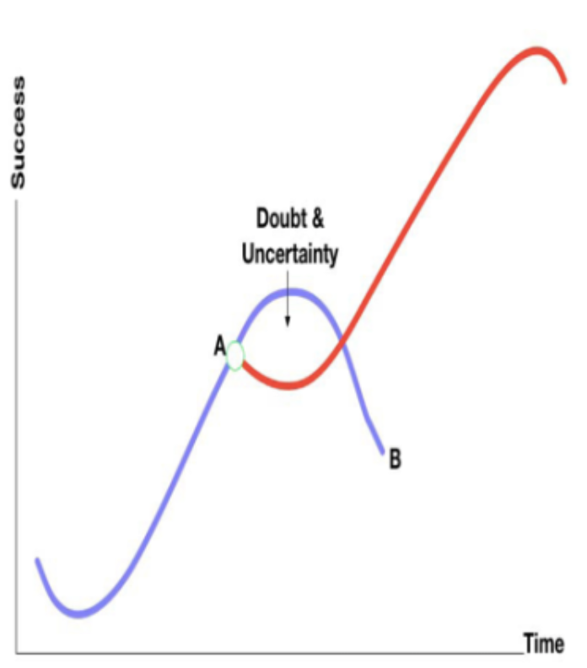
Side hustle
To real job?

Slide 8
Growth
marketing
sales
process
product/ service
pricing
Strategy fundamentals
What problem exists & how am I solving it?
Find your customers
Know your value
execute that solution more than once
Improve your product/service

Slide 9
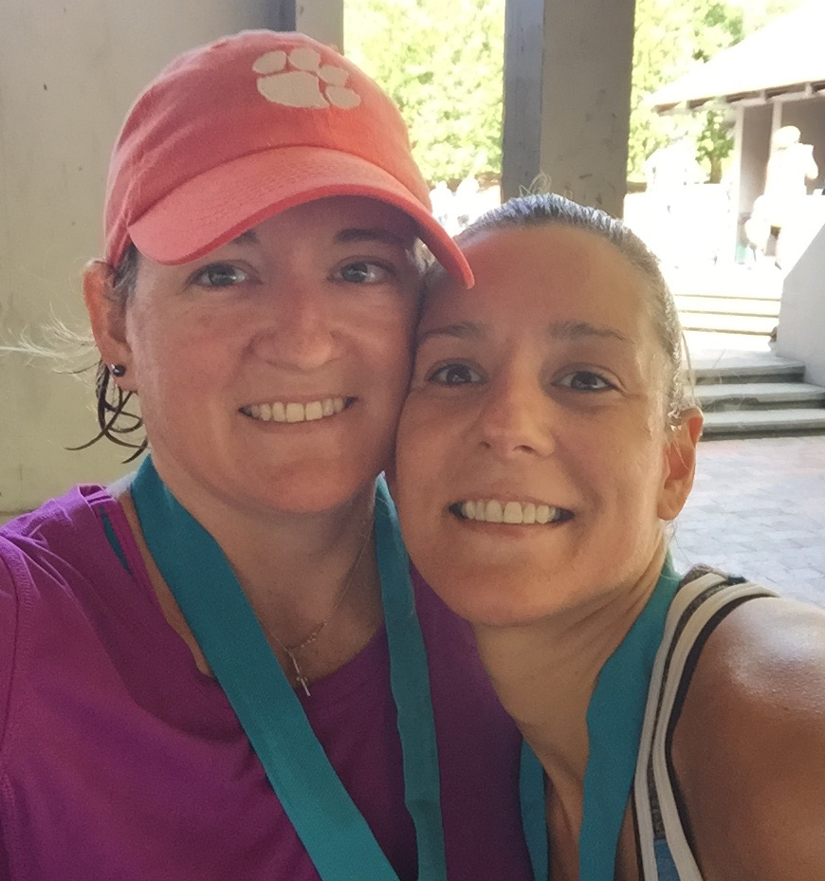
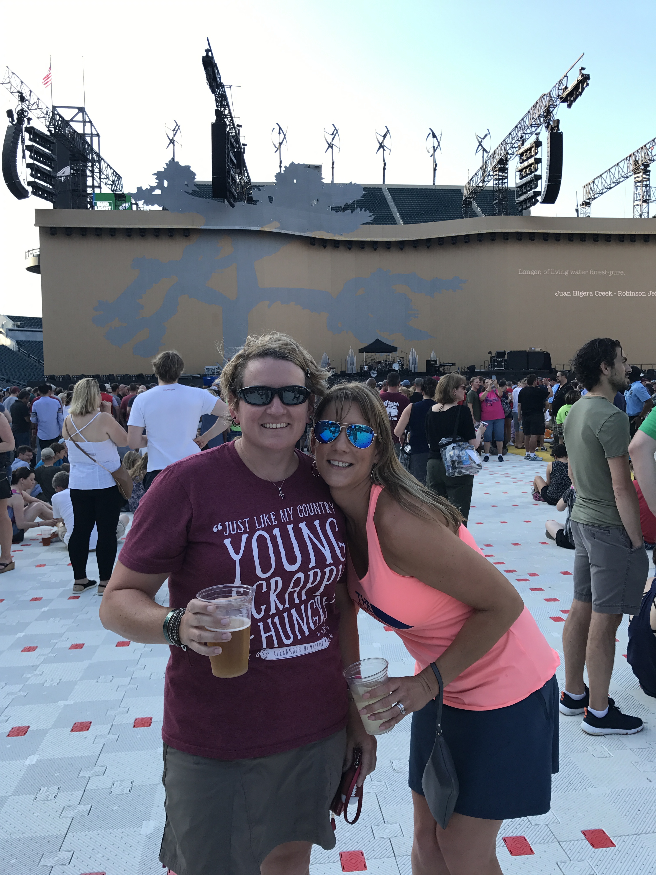
key questions to ask before you hire:
Why do I need to hire someone?
What is it they would do that I cannot do on my own?
How will I know they are contributing value to the company?
What kind of person do I want to trust, invest in, and share this with?

Slide 10
Taking the leap
Laid off
Retired
Sick of working for the man

Slide 11
strategies
Quarterly
One year
Five years
You don’t have to know exactly where you’re headed to know it’s better than where you’ve been.

Slide 12
Business card exercise
Running enthusiast
Notes:
Group participants and give each group a business card. Ask them to decide what kind of business the card represents.

Slide 13
viability
tenacity
adaptability
resilience
persistence
Willingness to change
Ability to overcome failure

Slide 14
Quick tips
marketing
legals
Have fun out there
Name the company something logical
Get a logo and use it everywhere
Get a tagline that says what you do
Social media is cheap but it’s time consuming; choose wisely
Go to every event where your customers will be
Get service contracts in writing
Have a basic services agreement
Have an attorney review your paperwork
Know tax laws regarding your business entity type & annual income
Working for yourself is fun
Sharing your talents is fun
Meeting new people is fun
Participating in the economy is fun
Having friends with start ups is fun
Learning something new is fun

Slide 15
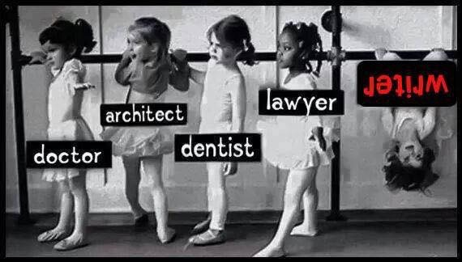
Never let the fear of striking out keep you from playing the game.

