Slide 1
Clemson road creative
How do Consultants Get Paid?
City of Columbia Office of Business Opportunities
Notes:
Welcome to Clemson Road Creative’s The ROAD Methodology learning module number one, What is Consulting?

Slide 2
Just another …
Co-Organizer of 1 Million Cups
Board of Directors of SC Writers Association
Chairperson, Richland County Libertarian Party
Radio show host, Write On SC
Dr. Kasie Whitener
Entrepreneur at Clemson Road Creative
Business Lecturer at the
Darla Moore School @ UofSC
Published Novelist
Co-Founder of the Women’s Business Center of SC @ Columbia College

Slide 3
How do consultants get paid?
In this workshop you will learn:
How to measure your available inventory
How to research competitive pricing
How to create a pricing strategy
How to make an offer that earns business and gets you paid
Notes:
I’m Dr. Kasie Whitener and I’ll be leading you through this initial module “What is Consulting?” during which we’ll discuss a basic vocabulary -- how consultants refer to their work and industry. Why people hire consultants and what people become consultants. We’ll look at how to become one -- even taking an assessment to see if it’s the right fit for you -- and finally the Real Work of Consulting which will set us up for Module 2.

Slide 4
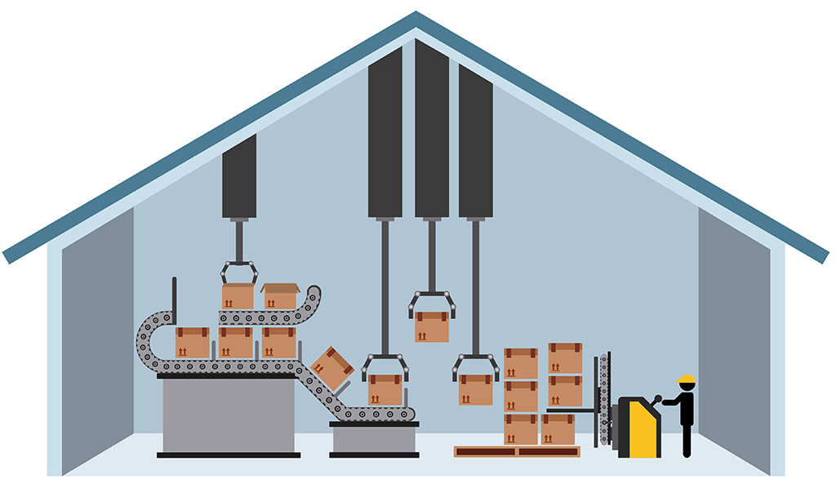
Consultant
What is Consulting Inventory?
Knowledge Work
What you know
How you transfer what you know
Available Time
For preparation
For delivery
Customers’ Available Time
Weekends & Holidays
Operating Hours
A person who provides expert advice professionally
This Photo by Unknown Author is licensed under CC BY
Notes:
What is consulting?
Delivering expertise to individuals with the intent of solving a specific problem. Consultants have the advantage of being subject matter experts (SMEs) in a particular field and bring to a project the experience of having executed similar work before. They are usually engaged for their knowledge but also for their outside-view, the fresh-eyes take on the project that eliminates the corporate politics of work being done by embedded individuals.
SMEs
Experience
Outsider view

Slide 5
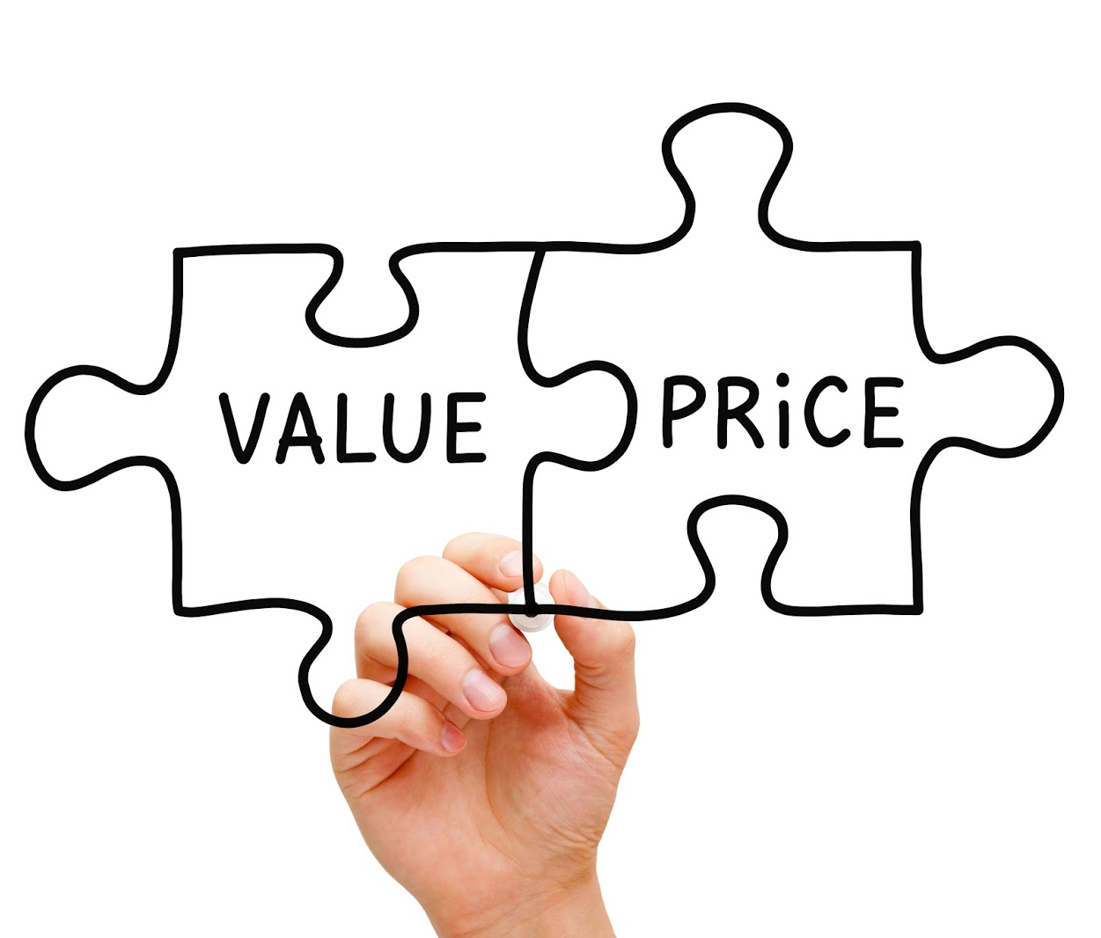
“It Depends.”
How do you determine pricing?
Market Value
Will or Skill?
Available Inventory
Client Urgency
Client Budget
The worst answer to the “How much does that cost?” question is, “It depends.”
How much is the special entree?
It depends on your side item.
How much is that car?
It depends on the features.
How much is that subscription?
It depends on premium channels.
This Photo by Unknown Author is licensed under CC BY-SA-NC

Slide 6
What does pricing depend on?
The client’s need. Your ability to meet that need.
The rest is negotiable.

Slide 7
strategy
Pricing Strategy
This blog breaks it down.
Price elasticity of demand
% Change in Quantity / % Change in Price = Price Elasticity of Demand
Does consulting have inelastic or elastic pricing?
Pricing Options:
Competition-Based Pricing
Cost-Plus Pricing
Dynamic Pricing
Freemium Pricing
High-Low Pricing
Hourly Pricing
Skimming Pricing
Penetration Pricing
Premium Pricing
Project-Based Pricing
Value-Based Pricing
An intentional process through which you arrive at a specific outcome.
Strategy is data-driven. Sometimes that data includes “gut instinct” but it’s data nonetheless.
This Photo by Unknown Author is licensed under CC BY-ND

Slide 8
Pricing options for consultants
Competition-Based Pricing
Cost-Plus Pricing
Freemium Pricing
Hourly Pricing
Project-Based Pricing
Value-Based Pricing
This Photo by Unknown Author is licensed under CC BY-NC-ND

Slide 9
worksheet
Let’s work up some pricing for three of the six strategies above and see what we come up with.
Start with Cost-Based because that will at least give us the baseline for what we NEED to make to cover our investment in the project.

Slide 10
What do you need to know?
Competition-Based Pricing – Who is your competition? What do they charge?
Cost-Plus Pricing – What are your expenses going to be?
Freemium Pricing – What can you afford to “give” away?
Hourly Pricing – How long will the work take?
Project-Based Pricing – What do others pay for the same project?
Value-Based Pricing – What is the impact of this project on the client’s overall operation? i.e. what’s it worth to them?

Slide 11
Are you undervaluing your service because you’re afraid they’ll say no?
What happens if they say no? What will they do without you? What will you do without them? Is it worth it to lower your price to win the business?

Slide 12
Pricing is an iterative process
Research
What do you need to know?
Trial & Error
What are you willing to risk?

Slide 13
Find some immovable standards
Research
5W & 1H
Trial & Error
Long term vs. short
What are you unwilling to accept?
What price demonstrates respect?
What price enables you to meet your expenses?
What strategy makes you willing to be transparent?
What doubts do you have about your rates and where do those doubts come from?
Can someone without your skills do this work? (will or skill?)
What does lowering your price signal to your client?

Slide 14
Get it in writing
Too many consultants are doing work without the right documentation.
Don’t be that guy.

Slide 15
professionalism
The Docs that Protect the Deal
Master Services Agreement
Blanket contract for all business, includes NDA
Get it read over by an attorney
Get your client to sign it first.
Statement of Work
Itemize the deliverables
Articulate the due dates and the change terms
Specify the payment terms and invoice dates
Get signed agreement from them before YOU sign.
You’re not being pushy or bossy or a pain in the ass when you ask for legally binding contracts to govern your work.
You’re being a professional.
If a client says otherwise, then tell them they’ll need to hire someone else for the job.
You’ll never regret turning away a relationship that starts off with them waving your professionalism away.
But you may regret taking them on as a client.

Slide 16
Clemson road creative
Setting standards
Clemson Road Creative certifies consultants to run their business using The R.O.A.D. Methodology. We offer:
CRC Academy learning experience
Shared Services Platform
Independent Consultants Keep their own company branding & operations
We support their operations with a portfolio of services:
Marketing
Knowledge Base / Learning Platform
Content Development
Documentation
Financial Services
Sales / Prospecting
Administrative support
Redesign work.
Never let the fear of striking out keep you from playing the game.

Slide 17
The road ahead
As you decide to be a consultant, remember every engagement you have is an opportunity to:
Do good work.
Serve others.
Learn more.
Perfect your craft.
Expand your network.
Put good energy into the world.

Slide 18
Let’s go to work.
Customer Validation: Who needs what you have to offer?
Service Offering Design & Testing: Build, Share, Get Feedback, Revise
Early Adopters: First Clients, Your Network, & Sustainability

Slide 19
Join our tribe
Sign up for the email list.
Register for upcoming webinars that revisit these topics.
Apply for CRC Academy.

